Slide 1
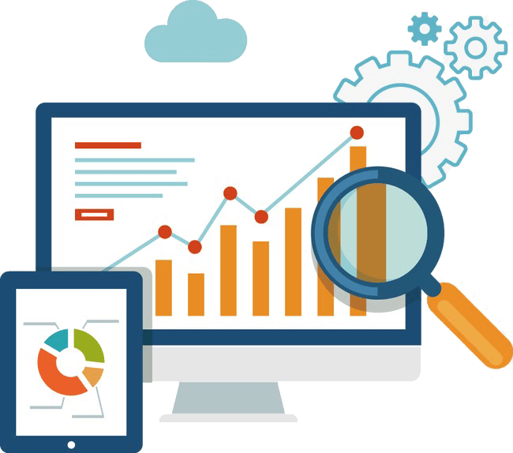
Applied Data
Visualization
Big Data Application
Qingyue Su

Slide 2
1
Life expectancy correlation
CONTENTS
2
Superstore loss
3
Earthquake distribution

Slide 3


Life Expectancy Correlation
01

Slide 4

Visualization 1: Life Expectancy Correlation
Data Source: Kaggle (WHO), Year: 2014
Some Variables:
Country: Country
Life expectancy: Life Expectancy in age
Alcohol: Alcohol recorded per capita (15+) consumption (in litres of pure alcohol)
percentage expenditure: Expenditure on health as a percentage of Gross Domestic Product per capita(%)
Hepatitis B：Hepatitis B (HepB) immunization coverage among 1-year-olds (%)
BMI：Average Body Mass Index of entire population
Total expenditure：General government expenditure on health as a percentage of total government expenditure (%)
thinness 5-9 years：Prevalence of thinness among children for Age 5 to 9(%)
Schooling：Number of years of Schooling(years)
Get rid of zero-value variables.
Two Hypotheses tested:
Alcohol v.s. life expectancy
Schooling v.s. GDP

Slide 5


02
Superstore Loss

Slide 6
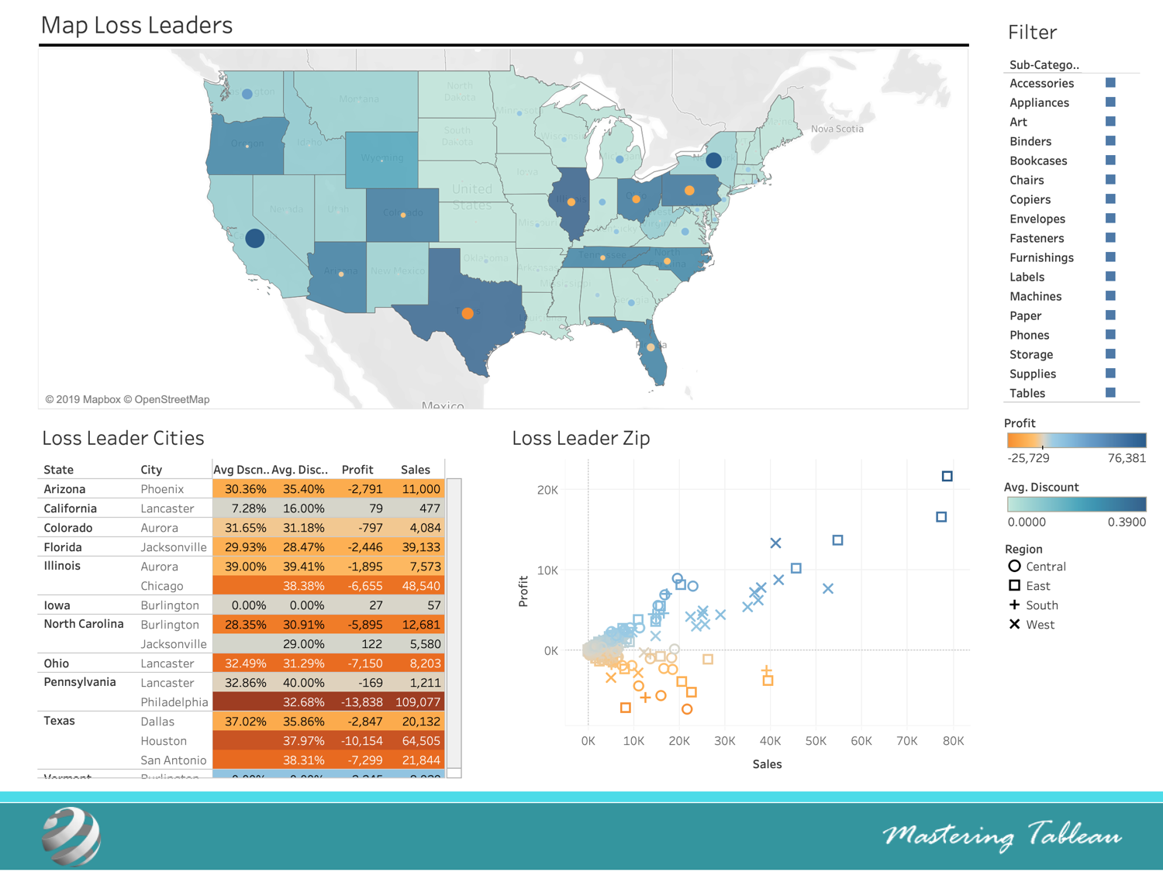
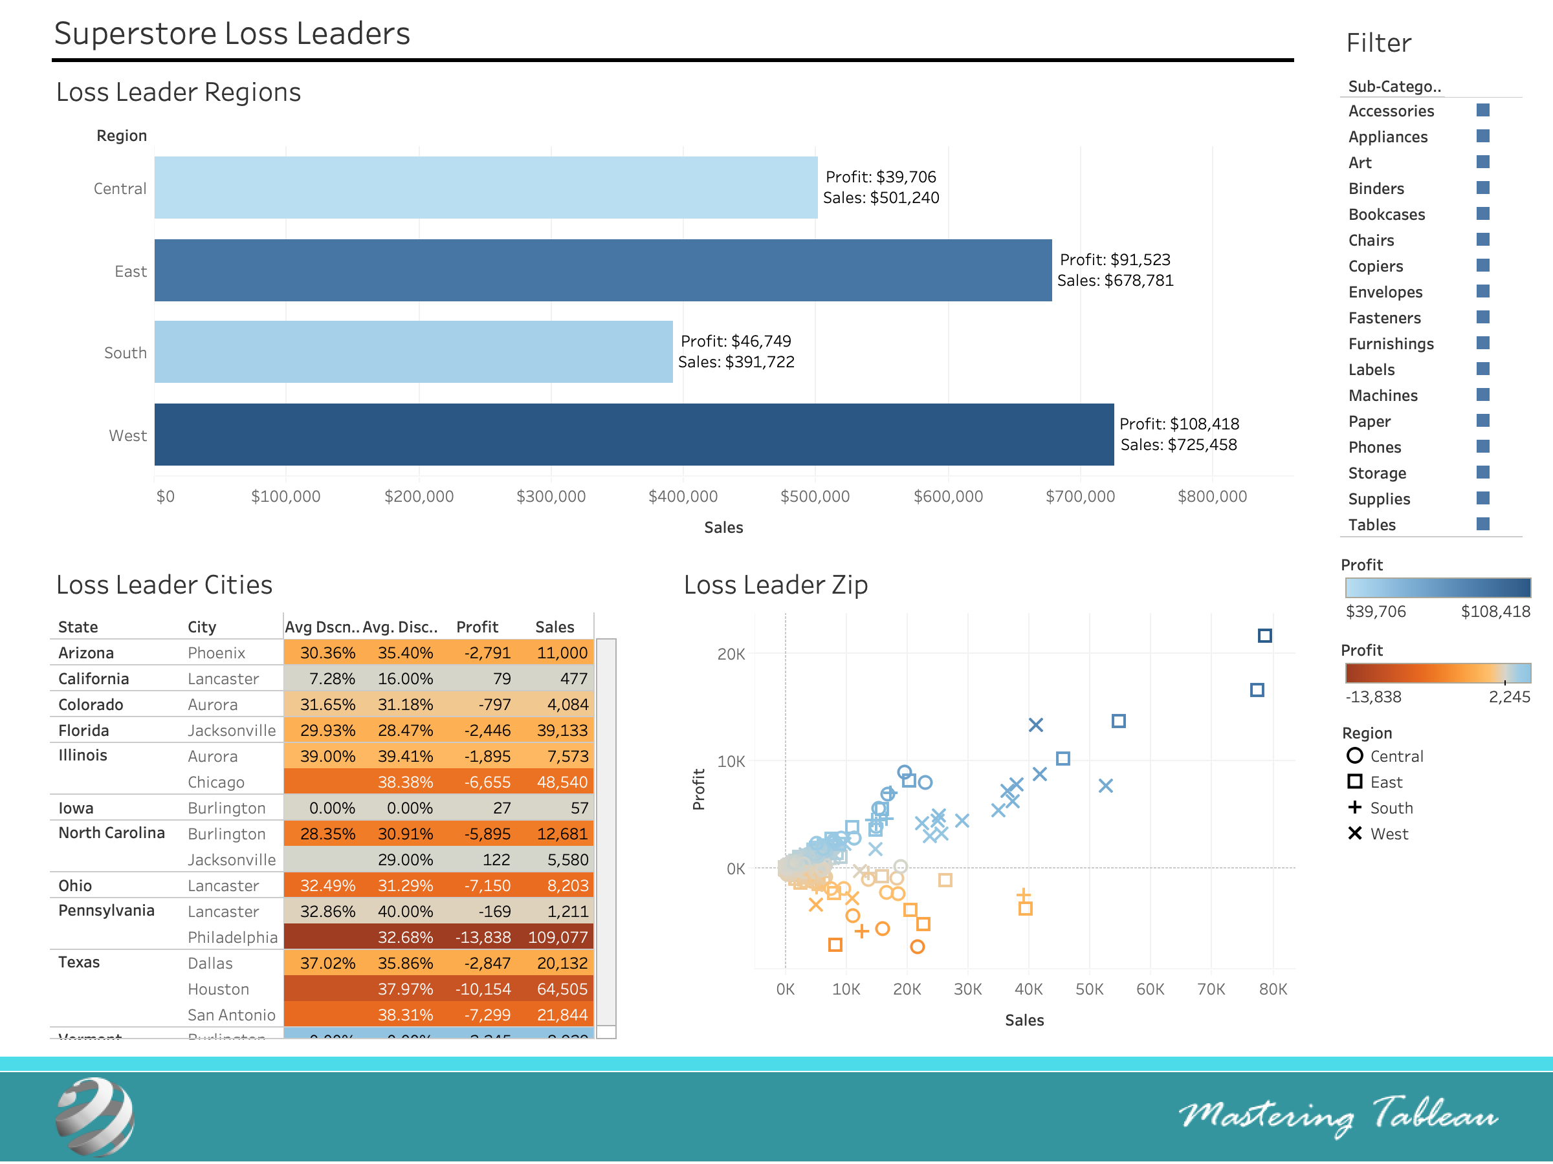
Visualization 2: two dashboards
Applied Data: the 2014-2017 records for all the superstores in US
(original data: 2011 records for all the superstores in US )
Dashboard 1: Map Loss Leaders
Dashboard 2: Superstore Loss Leaders

Slide 7
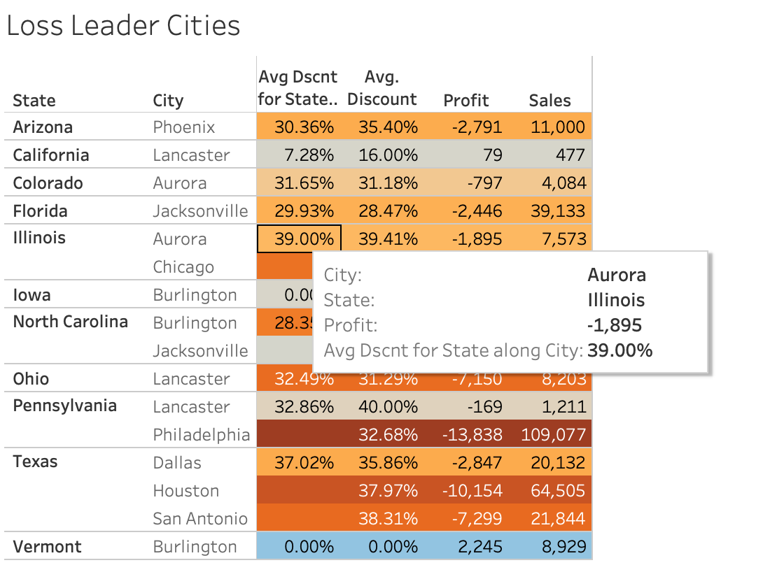
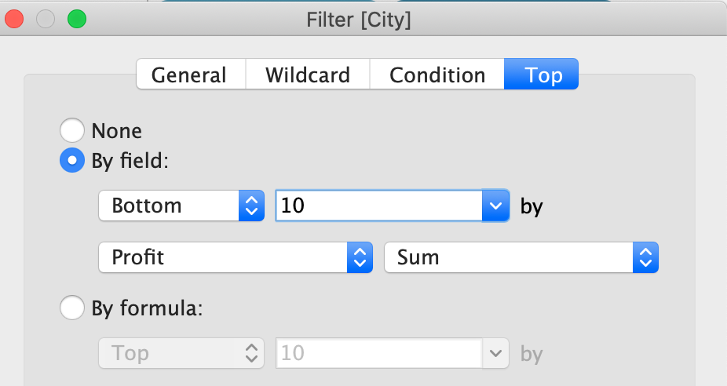
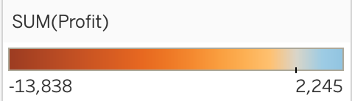
Visualization 2: table
Highest Average Discount: Aurora, Illinois;
Lowest Profit: Philadelphia, Pennsylvania
“Cities in one state share similar operating characteristics ~”

Slide 8
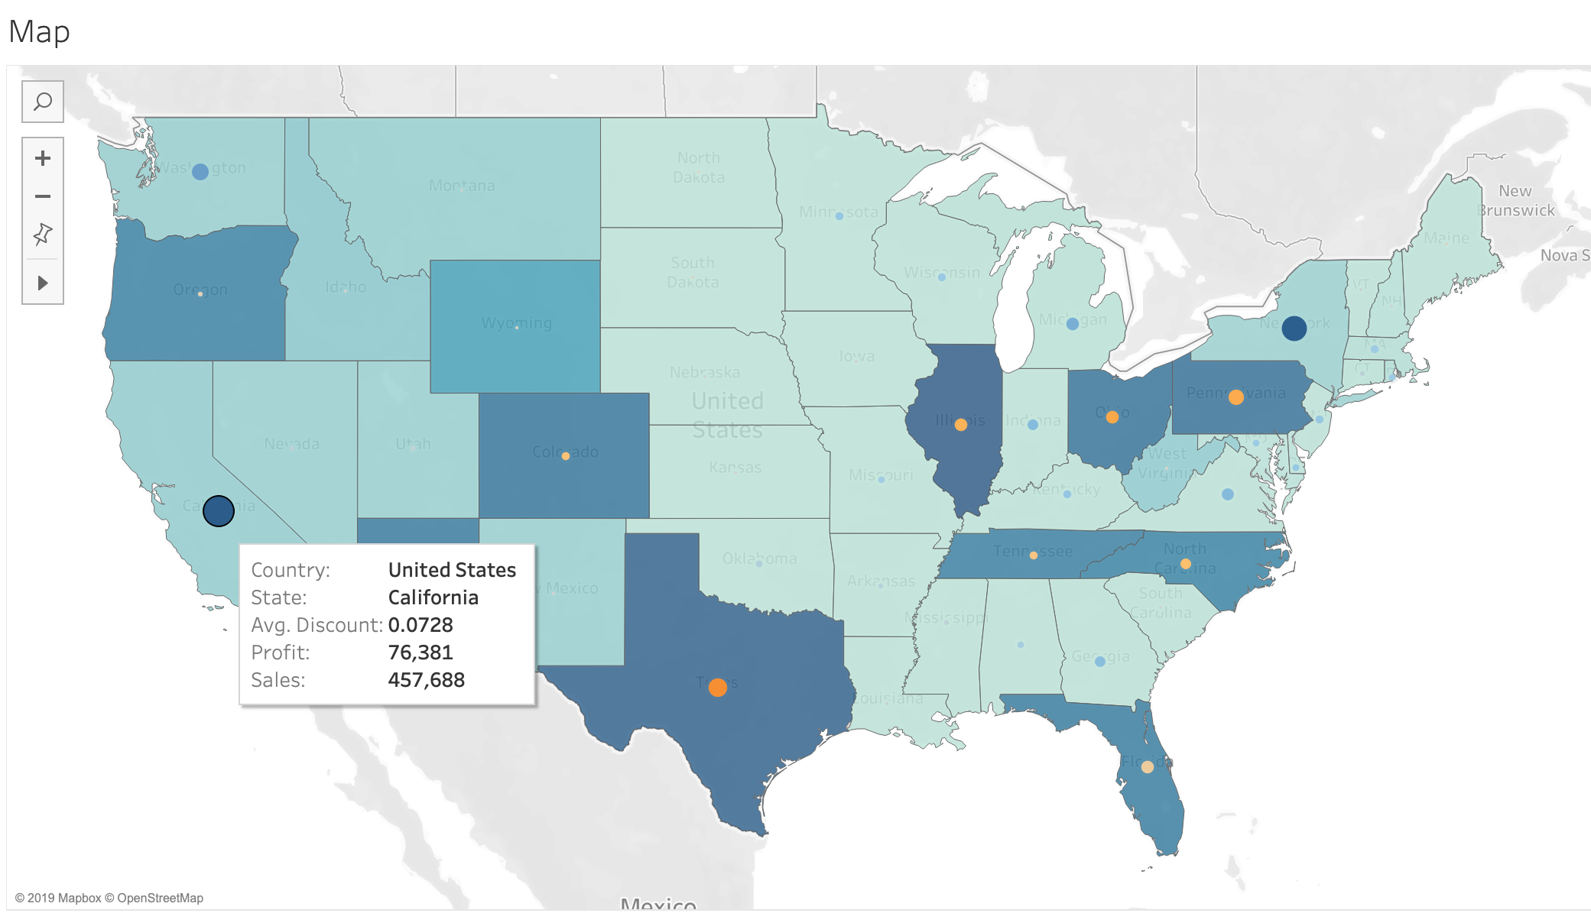
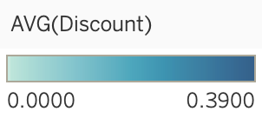
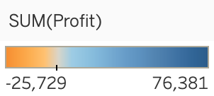
Visualization 2: map
State Color: AVG(Discount)
Circle Color & Size
Legend:
Basic information
Highest Average Discount: Illinois, Texas;
Lowest Profit: Texas
“ There exists some relationships between average discount and profit ~ ”
“ How about the trend in region?”

Slide 9
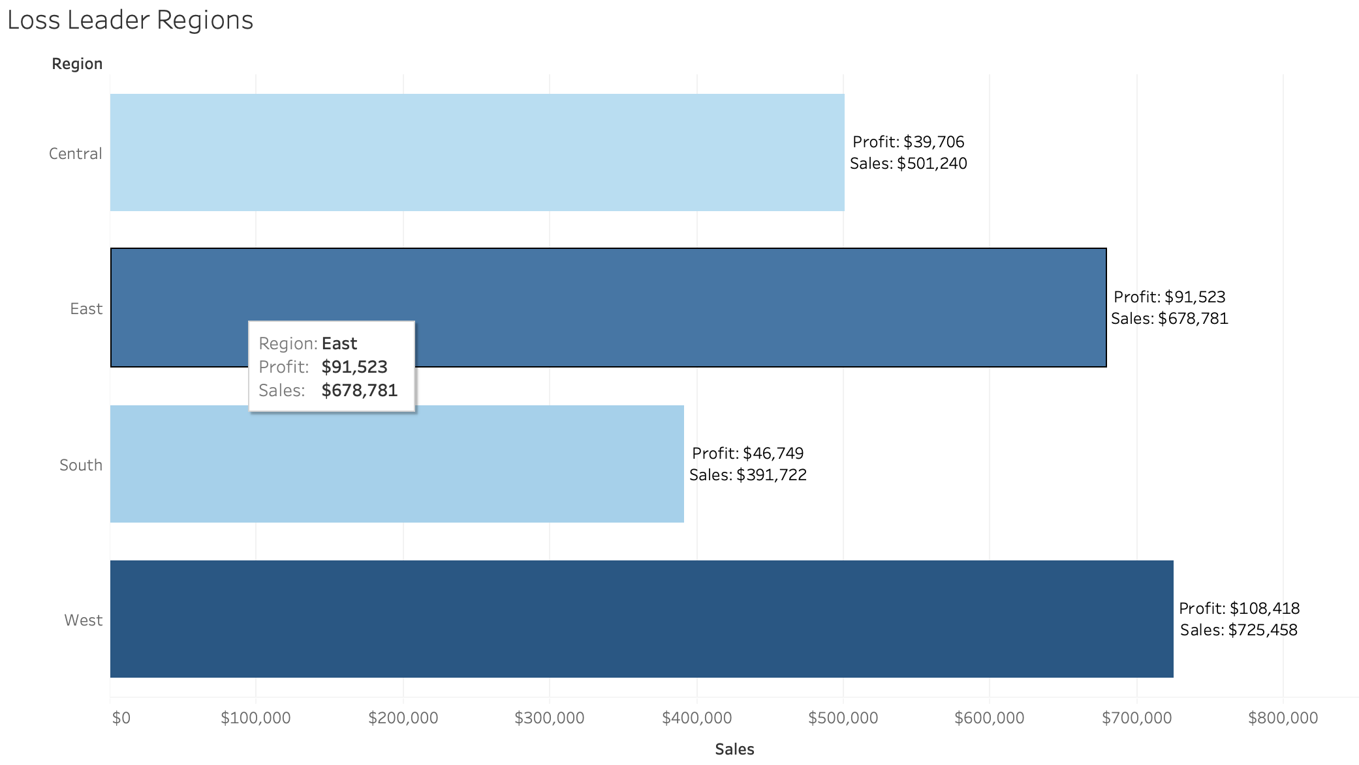
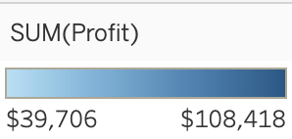
Visualization 2: bar chart
Lowest Profit & Lowest Sales

Slide 10
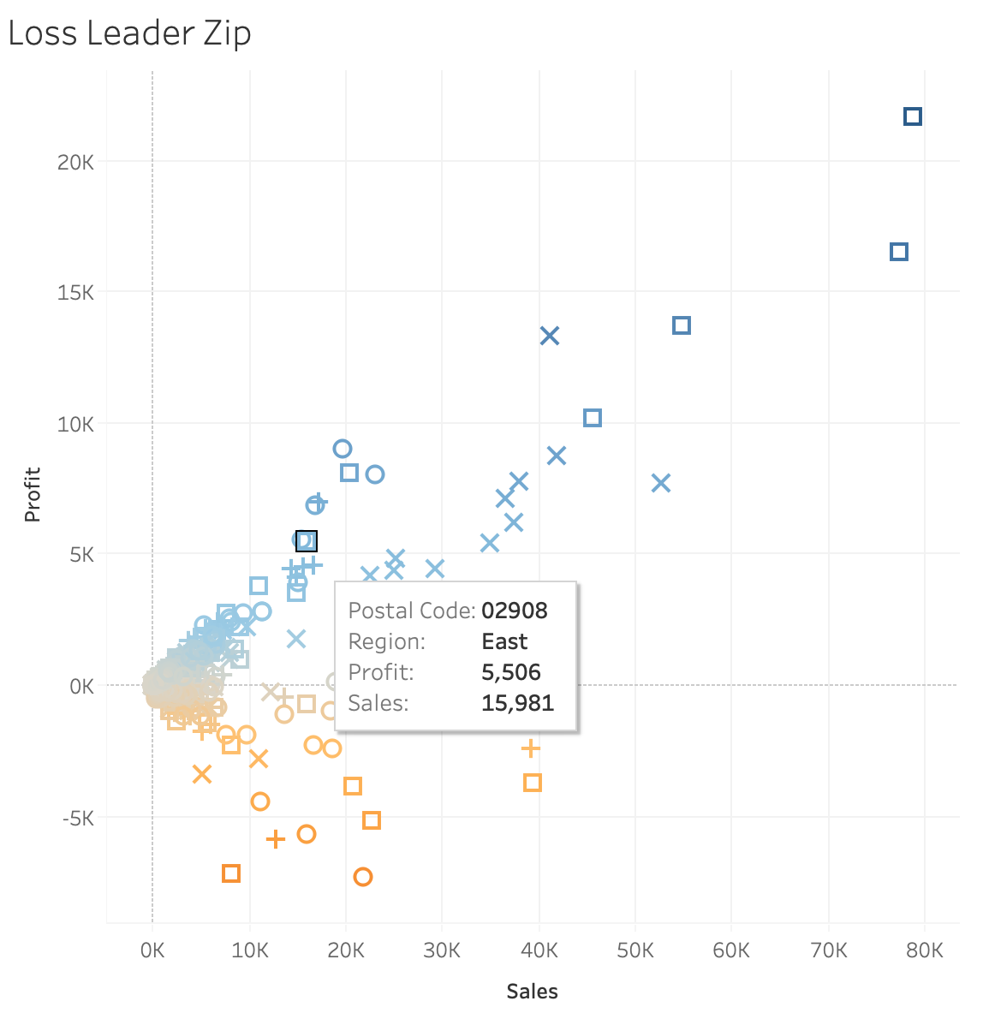
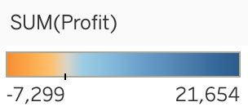
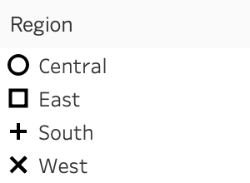
Visualization 2: scatter plot
Data from East and West~
Data from South are all focused here!

Slide 11

Heatmap and Forecasting
03

Slide 12
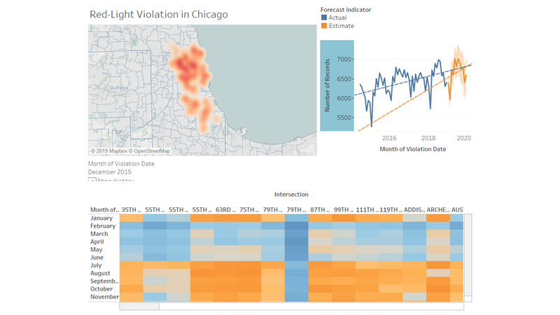

Slide 13
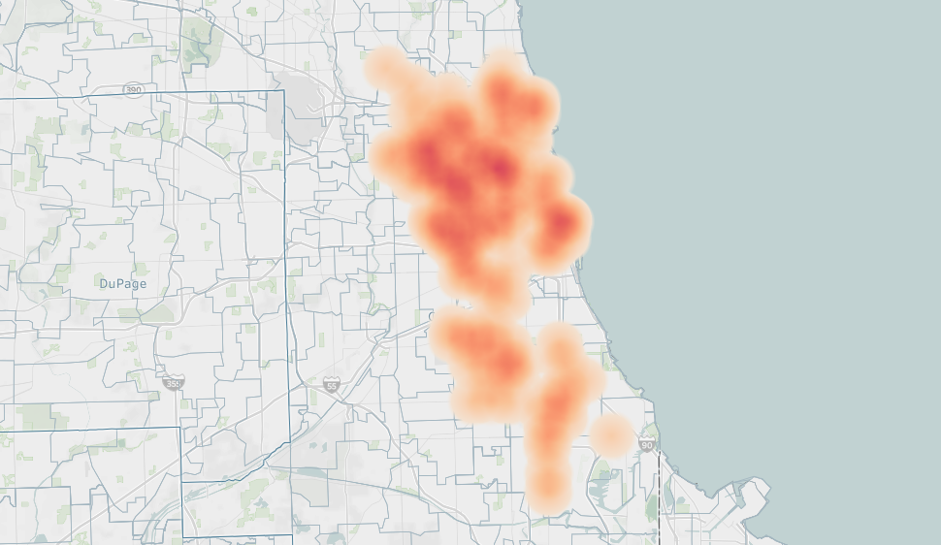

Slide 14
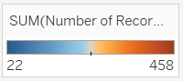
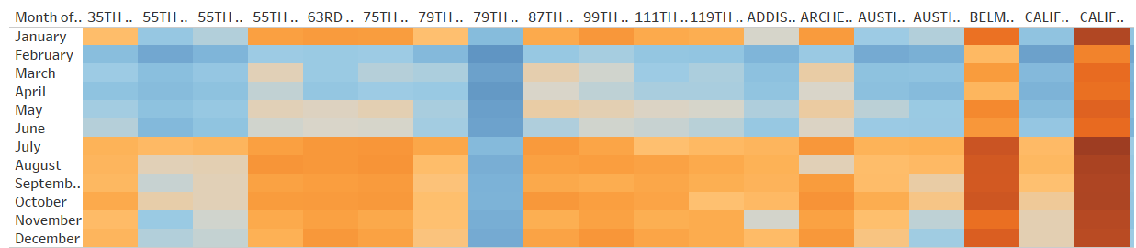
Heatmap
Indicate severer violations in the second half of year

Slide 15
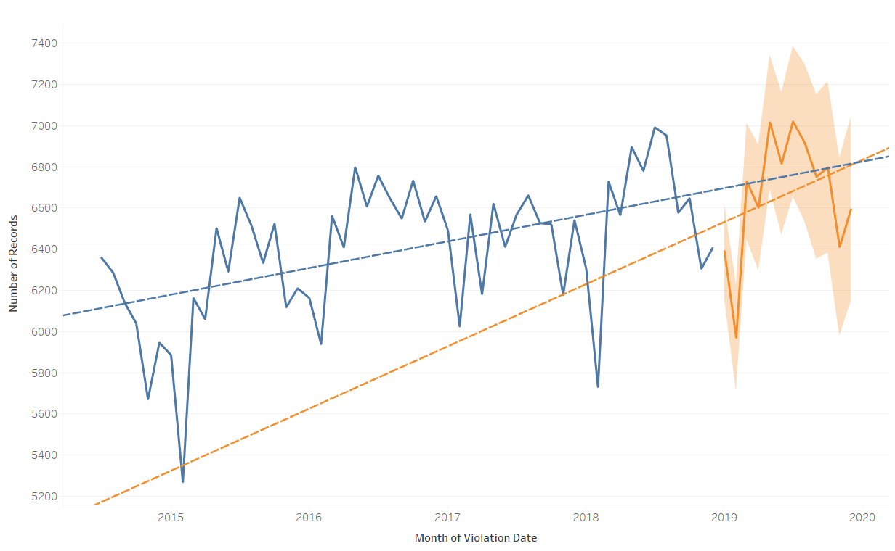
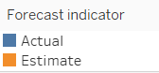
Forecasting

Slide 16
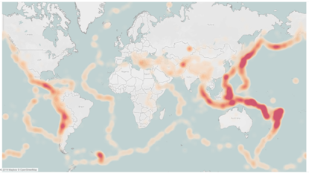
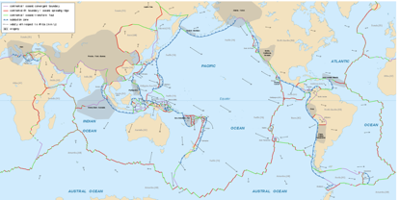
Visualization 3:

Slide 17
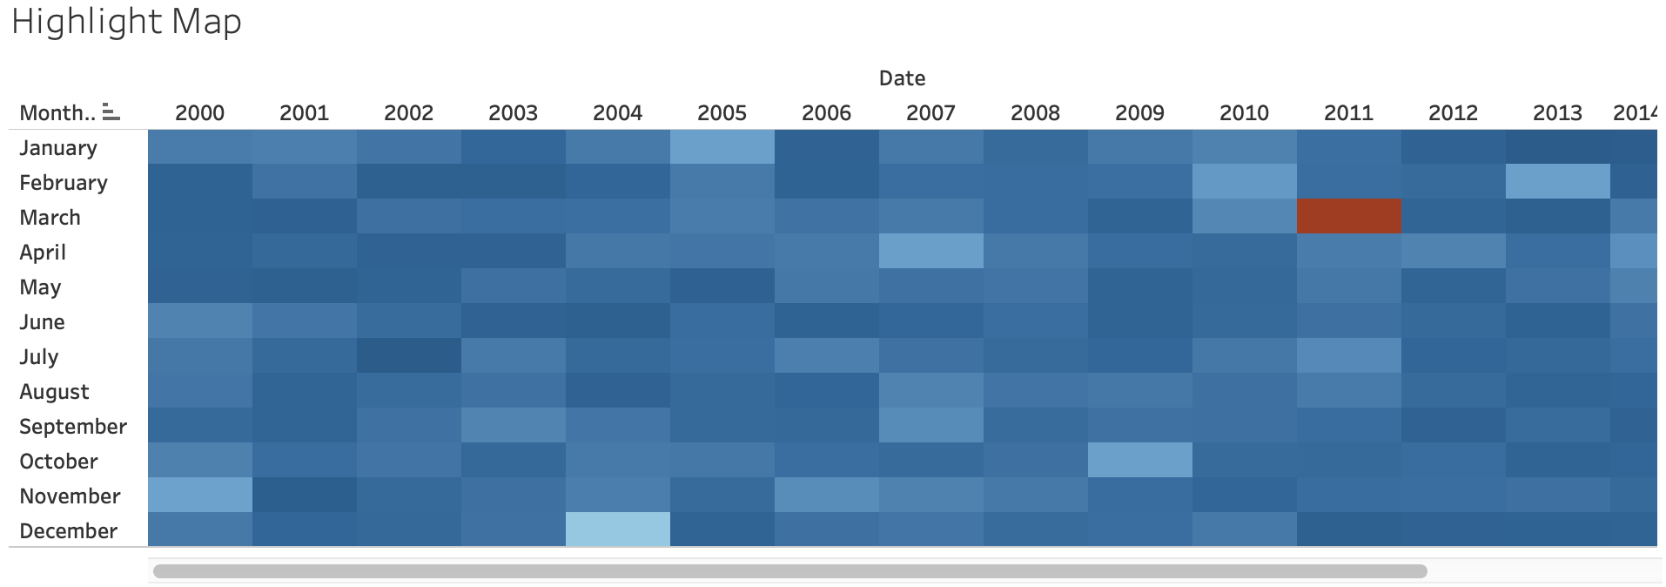
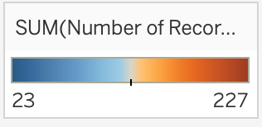
Visualization 3:

Slide 18
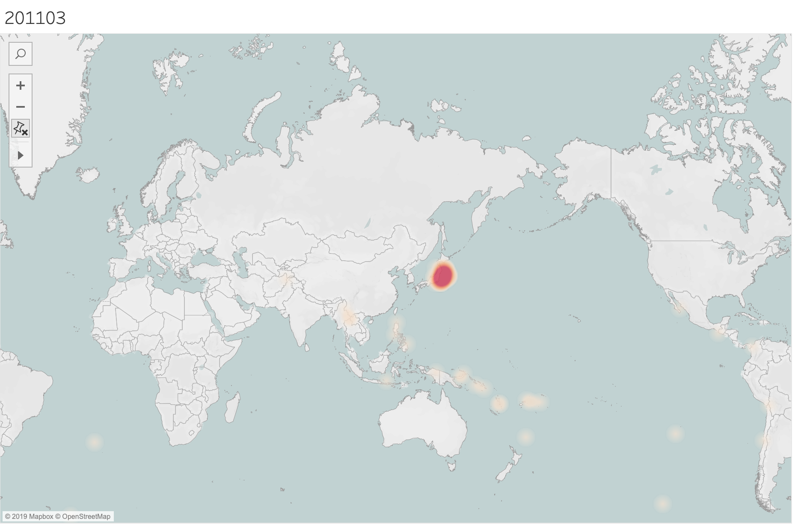
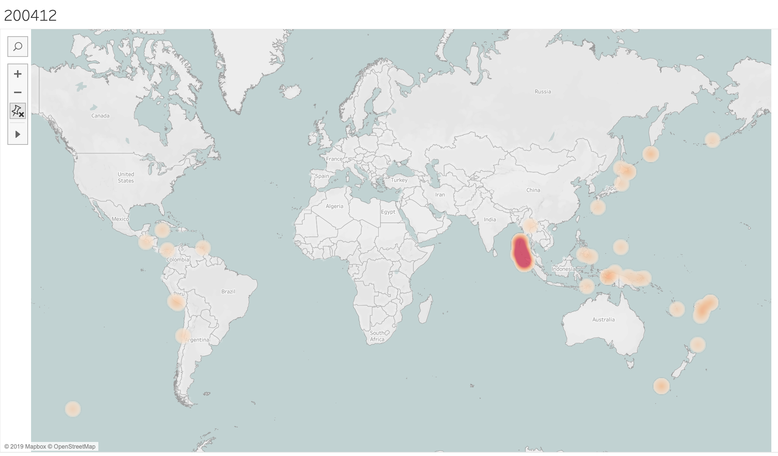
Visualization 3:
311 Earthquake in Japan
Indian Ocean earthquake and tsunami in 2004

Slide 19
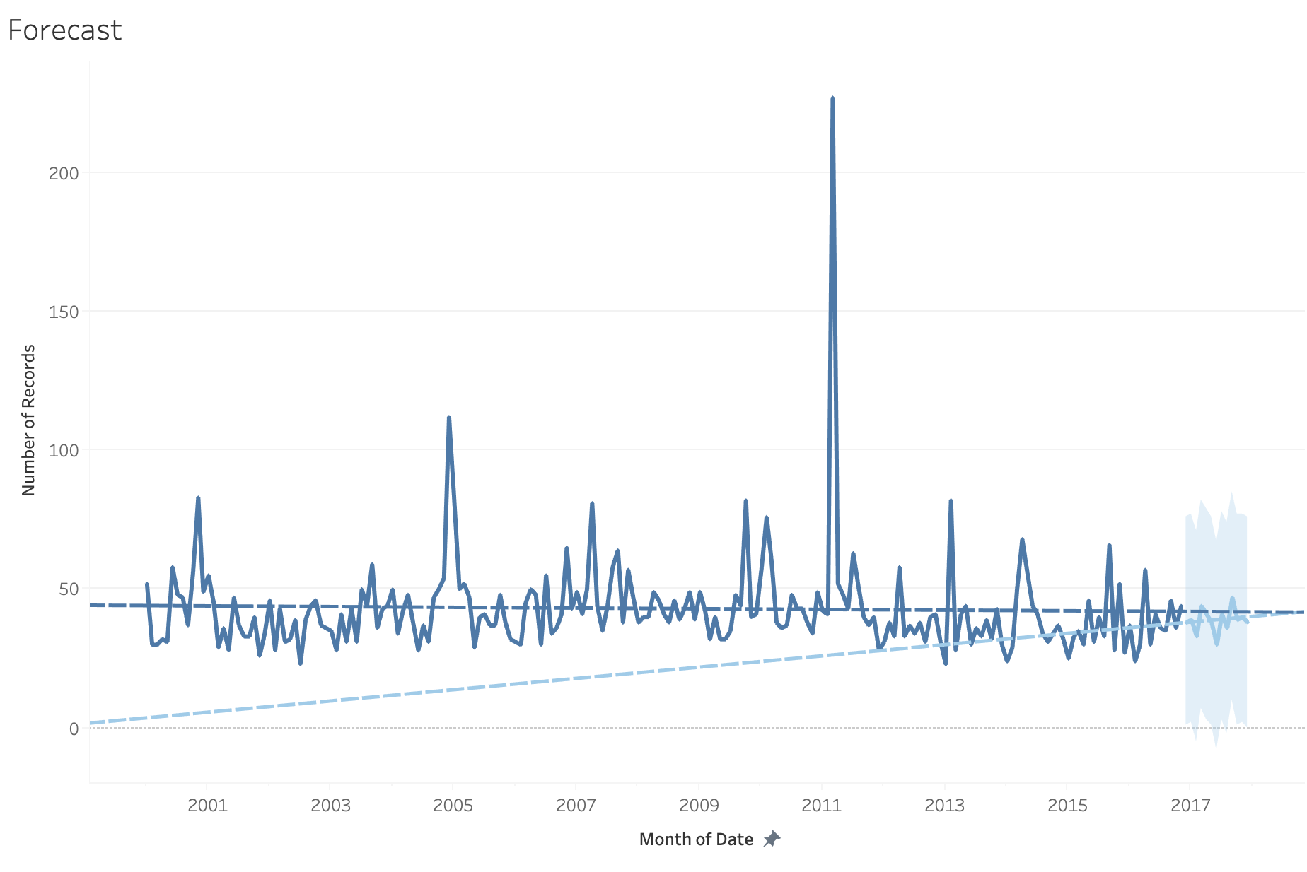
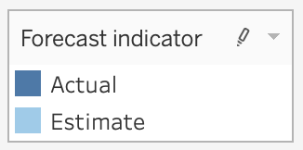
Visualization 3:

Slide 20
THANK YOU!

